Slide 1
Reports Tab
The system contains a very powerful Management Reporting function
Reports can be generated as Dashboards. There are a total of 39 standard dashboard reports available
Customised reports can also be created via List and Spotlights views
Additional training on creating reports will be available once the system has been populated with data for meaningful analysis

Slide 2
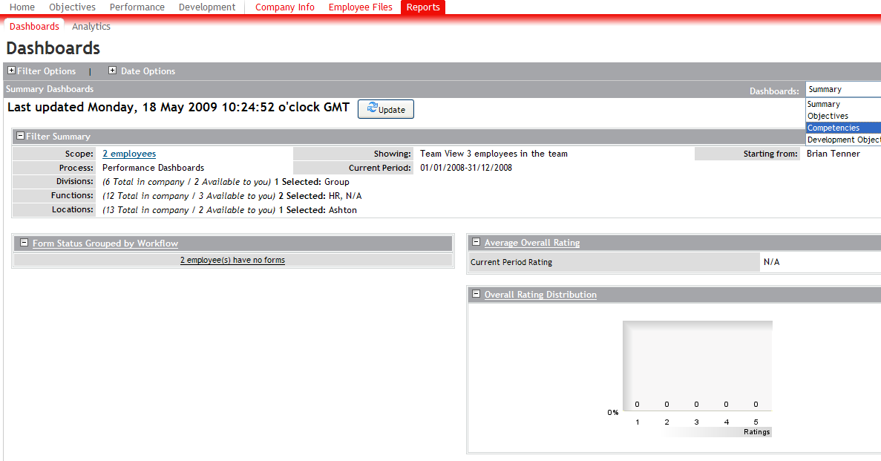
Reports Tab – Dashboards
Dashboards available in following categories. Use drop down menu

Slide 3
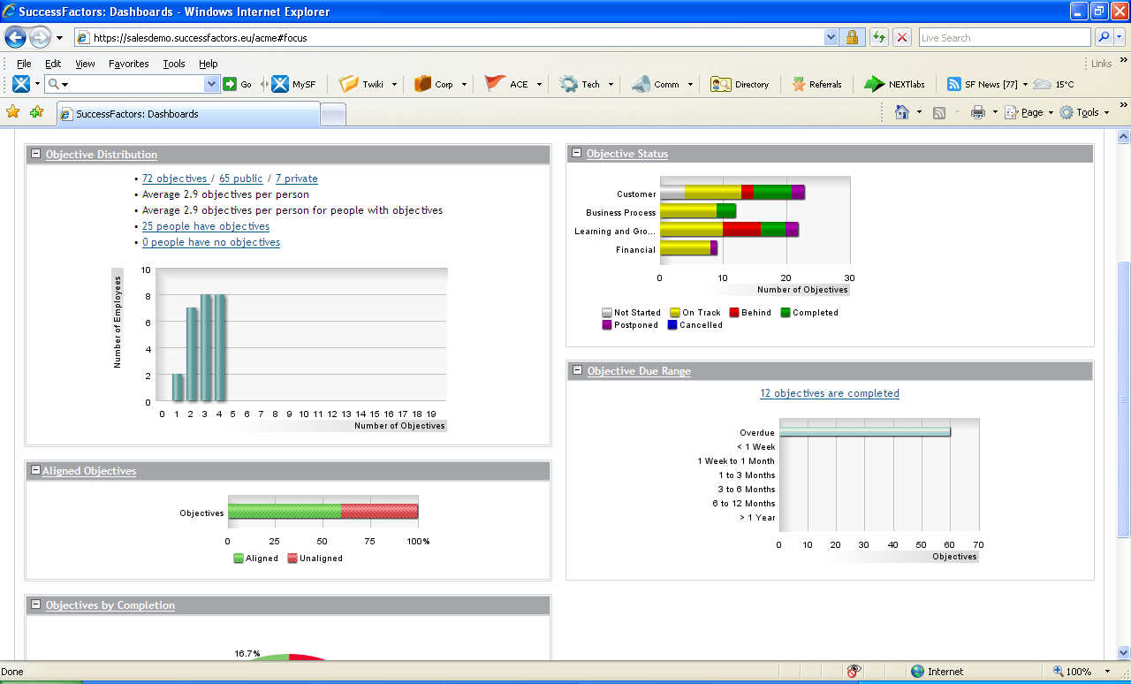
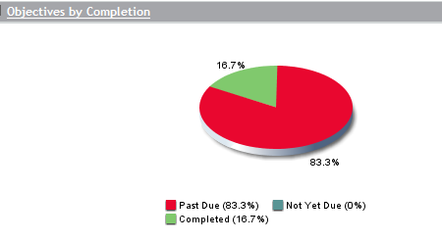
Exploring the Reports Tab – Dashboards Examples for objectives
`

Slide 4
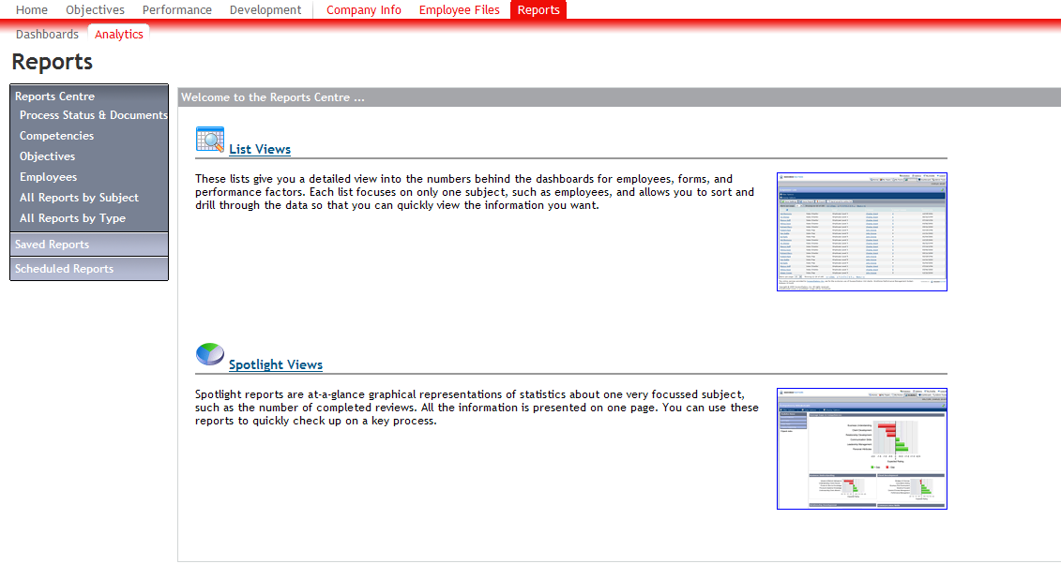
Reports Tab - Analytics

